Slide 1
Health technology assessment view on external information
Beate Wieseler
10th Statistics and Biopharmacy Conference
Advancing drug development though innovative designs and efficient data use
10 October 2025

Slide 2
Agenda
What is HTA?
External information in HTA
European HTA Regulation
Scientific question
Assessment approach
EU HTA guidance (on external controls)
Experience with external controls
Conclusion

Slide 3
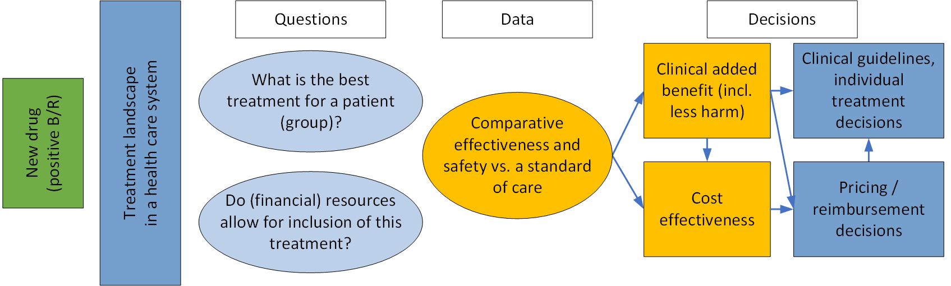
HTA decision making (1)

Slide 4
HTA decision making (2)

Slide 5
Use of external data in HTA
Today we are not talking about
Today we are talking about
Use of external information from routine practice data, e.g.
size of a specific patient population
treatment patterns in clinical practice
characteristics of patients with a given disease
costs of treatment in a patient group
…
Treatment effects of new drugs
health outcomes causally related to treatments
comparative effectiveness comparing treatment outcomes of alternative interventions
the description of the certainty of the effect estimates

Slide 6
Regulation (EU) 2021/2282 on HTA
Article 9 (1) A joint clinical assessment shall result in a joint clinical assessment report that shall be accompanied by a summary report. Those reports shall not contain any value judgement or conclusions on the overall clinical added value of the assessed health technology and shall be limited to a description of the scientific analysis:
(a) of the relative effects of the health technology as assessed on the health outcomes against the chosen parameters which are based on the assessment scope as set out pursuant to Article 8(6);
(b) of the degree of certainty of the relative effects, taking into account the strengths and limitations of the available evidence.
The Joint Clinical Assessment is a factual description of the available evidence and it’s certainty – the decision on the acceptability of any uncertainty is taken at the national level

Slide 7
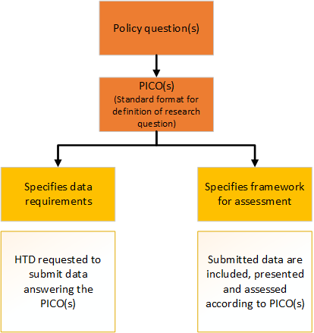
The starting point: the assessment scope
Starting point: policy question of Member States
Translated into standard format for a scientific assessments: PICO
Must be inclusive and meet the requirements of the Member States
Dossier should include data to answer the PICO questions
JCA report describes data availability, relative effectiveness and safety and certainty of results per PICO
https://health.ec.europa.eu/publications/guidance-scoping-process_en
Notes:
All MS needs, no majority vote

Slide 8
EU HTA guidance for the assessment
P
Population
I
Intervention
C
Outcomes
O
Comparator
Degree of certainty of relative effects
PICO definition
Quantitative evidence synthesis: direct and indirect comparisons
Endpoints (clinical, PROs, surrogates [incl. validation], … )
Assessment of certainty of effects (incl. strength and limitations of available evidence)
https://health.ec.europa.eu/health-technology-assessment/key-documents_en?f%5B0%5D=topic_topic%3A227

Slide 9
The Scoping process
The assessment team (from 2 Member States) develops an assessment scope proposal (PICO proposal) based on the indication applied for by the Health Technology Developer
Member States provide their feedback on the proposal reflecting their needs with regard to the PICOs
The assessment team consolidates the feedback into an opimised number of PICOs
The assessment scope is validated by the Member States
The assessment scope is communicated to the Health Technology Developer

Slide 10
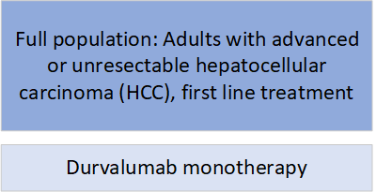
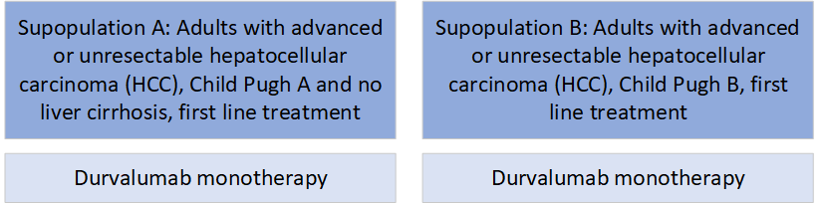
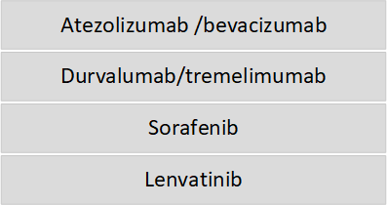
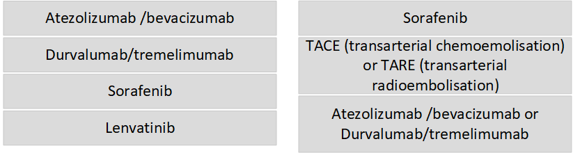
Example PICOs (preparatory PICO exercise)
P
I
C

Slide 11
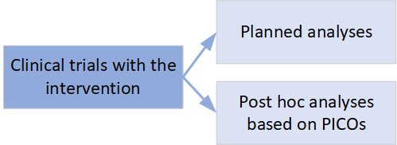
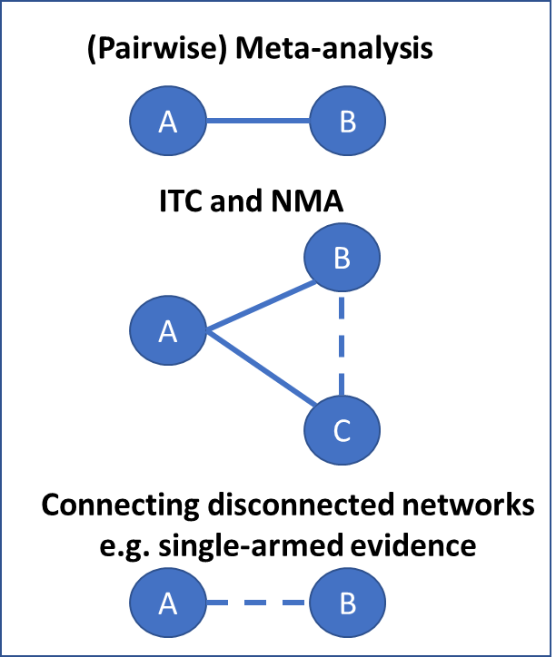
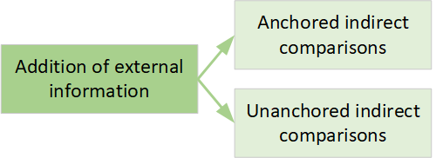

From the PICO to evidence for the JCA
Methodological requirements for direct and indirect comparisons provided in the Guidance on evidence synthesis

Slide 12
Guidance on evidence synthesis: direct comparisons and anchored ITCs from RCTs
Direct comparisons from RCTs – individual studies or pairwise meta-analysis – highest certainty of evidence
Indirect Treatment Comparisons (ITC) from RCTs
Bucher‘s method for anchored indirect comparisons
Network meta-analyses
Population-adjusted methods for indirect comparison (anchored MAIC, STC, ML-NMR) may be considered to address differences in effect-modifying characteristics
Both direct and indirect comparisons require the same underlying assumption of exchangeability across studies
Anchored ITC, i.e. synthesis of relative treatment effects using methods that preserve randomisation, provide better certainty of evidence than unanchored ITC
MEMBER STATE COORDINATION GROUP ON HEALTH TECHNOLOGY ASSESSMENT

Slide 13
Guidance on evidence synthesis: un-anchored ITCs
Un-anchored ITCs, e.g. comparisons of single armed trials with external controls, are non-randomised studies
additional potential for bias arising from combining data from different sources
In HTA, ITCs required for effect-estimation, not just contextualisation
Requires adjustment for confounding using appropriate methods, e.g., propensity score matching/weighting
model and covariate selection strategies should be prespecified and transparent
access to full IPD required
mixed IPD – aggregated data methods (un-anchored MAIC or STC) are not in general sufficient
Possibility of unmeasured confounding => additional uncertainty
Shifted null hypothesis testing
Quantitative analysis of bias (e.g. E-values)….

Slide 14
Acceptability of methods in JCA
Pragmatic approach: most (reasonable) methods can be of value for JCA in principle, provided underlying assumptions hold and target effect estimate is relevant
no methods excluded from consideration a-priori
new methods can be used if sufficiently justified and described
Onus on HTD to provide evidence of validity of analyses that they submit
lack of suitable alternatives does not imply validity (“best available evidence”)
In line with the regulation
JCA will assess the validity and uncertainty of the results
acceptability is a decision for individual MS

Slide 15
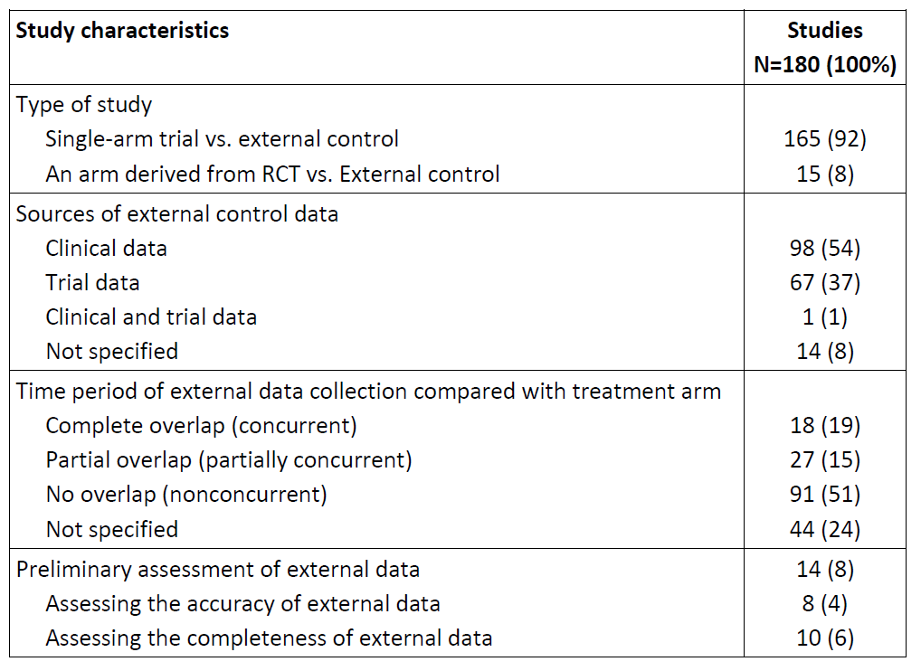
External controls in practise
External controls in practise (1)
Studies published in journals between 2010 and 2023
Liu J. et al. Design, Conduct, and Analysis of Externally Controlled Trials. JAMA Netw Open. 2025; 8(9):e2530277.

Slide 16
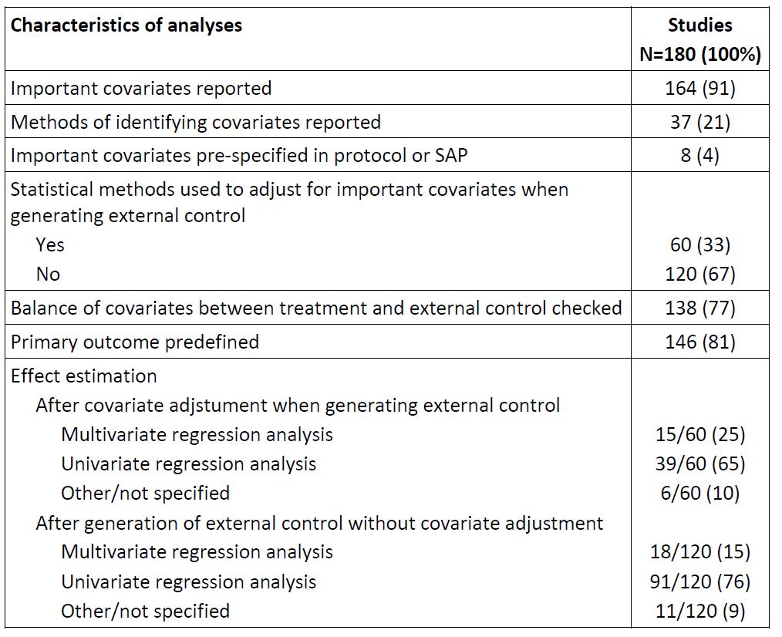
External controls in practise (2)
Studies published in journals between 2010 and 2023
Liu J. et al. Design, Conduct, and Analysis of Externally Controlled Trials. JAMA Netw Open. 2025; 8(9):e2530277.

Slide 17
External controls in HTA
Case study: assessment of new cancer drugs in Germany
Sample: health technology assessments of cancer drugs started at IQWiG between June 2021 and December 2021
HTAs covering 27 cancer drugs with 40 research questions
 | Direct comparisons vs. SOC (RCT) | Anchored indirect comparison vs. SOC | No acceptable evidence vs. SOC available | Total
HTAs of cancer drugs | 19/40 (48%) | 7/40 (18%) | 14/40 (35%) | 40/40 (100%)
No data submitted:
3/14
Single arm trials (with and without external controls):
11/14

Slide 18
External control in HTA: the Lisocabtagene case study
Assessment of lisocabtagene maraleucel vs. an individualised treatment in r/r DLBCL considering patient characteristics (e.g. pre-treatment, ECOG-PS, course of disease etc.)
available data: comparison of single-arm trial against external control arm from RWD (non-interventional retrospective study in various data sources: OTA, Flatiron, Guardian Research Network)
data on relevant patient characteristics missing in these data sources (e.g. 41% no data on ECOG-PS, 96% no data on IPI, 29% no Ann Arbor staging) =>similarity cannot be assessed
differences in time and type of treatment (start of treatment 2016-18 vs. unknown [first diagnosis since 2003]; 30% vs. 10% with SCT; low rates of newer treatment options in comparator arm) =>similarity of pre-/concomitant treatment potentially not given
data on confounders missing (12 out of 29 confounders not considered in the analyses due to >30% missing data) =>appropriate confounder adjustment not possible
only data on overall survival, no data on adverse events, no data on symptoms, no data on HRQoL =>relevant endpoints missing
PM?
Out of sample?
Out of DLBCL? – G-BA Beschlüsse zu DLBCL examples?
https://www.g-ba.de/bewertungsverfahren/nutzenbewertung/869/

Slide 19
Prospective data collection for external controls
Special procedure in Germany: in case of insufficient evidence for decision making, G-BA can request data collection from routine practise data sources (non-randomised) and analysis for submission for HTA
Health technology developer has to develop and submit the protocol and SAP for the study
studies usually based on existing patient registries
so far retrospective external controls not possible due to insufficient data (quantity and quality) in the registries => prospective non-randomised comparative data collection
regular points of discussion: systematic confounder identification, sufficient data collection for adjustment, data collection for relevant endpoints, sufficient data collection for comparator treatment, pre-specification of analyses

Slide 20
Conclusion
In current HTA submissions the use of external controls often does not meet the methodological requirements
Additional methods enabling comparative effectiveness analyses are welcome
However, when suggesting a new method
the design of any study using new analysis approaches should be specified
data requirements should be considered and clearly described
upfront feasability studies should be considered
methods should include (testable) considerations on the certainty of the resulting evidence and its description
reporting requirements for both study planning and analysis should be defined

Slide 21


Institute for Quality and Efficiency in Health Care (IQWiG)

