Slide 1



Eight Methodological Questions
for Digital Outcome Measures
Statistics and Biopharmacy Conference 2025
Mia Tackney, NIHR Advanced Fellow
James Carpenter MRC-CTU at UCL
Sofía Villar, MRC-BSU, University of Cambridge
Notes:
Methodological questions that need more attention when it comes to novel digital outcomes

Slide 2
Goals for this talk
To provide an overview of:
Potential of digital outcome measures (two iconic examples)
Key Methodological Questions:
In Validating Digital Outcome Measures
In using Digital Outcome Measures in Clinical Trials
Consequences on Primary Analysis via a Simulation Study
Notes:
Two iconic examples of digital outcomes which have been used as primary outcomes in phase III trials;
Intersperse 8 methodological questions: some to do with validation (how do you know that these are just as good as traditional outcomes); some are to do with actually using these novel outcomes in trials and new considerations that arise.

Slide 3

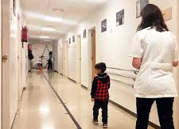
The Six-Minute Walk Test
Gold-standard outcome for clinical trials in many diseases which affect mobility, e.g:
Duchenne Muscular Dystrophy
Pulmonary Hypertension
Some recognised limitations:
Places high burden on patients;
May not meaningfully measure patient experience;
‘Snapshot’ measure – affected by fatigue, motivation.
Notes:
How we measure outcome/endpoints in clinical trials lots of diseases areas which affect physical activity, the gold standard way to measure someone’s health is with the 6-minute walk test - measure outcome/endpoint of a clinical trial using a digital device - usually in a way that allows for decentralisation of the trial
-

Slide 4
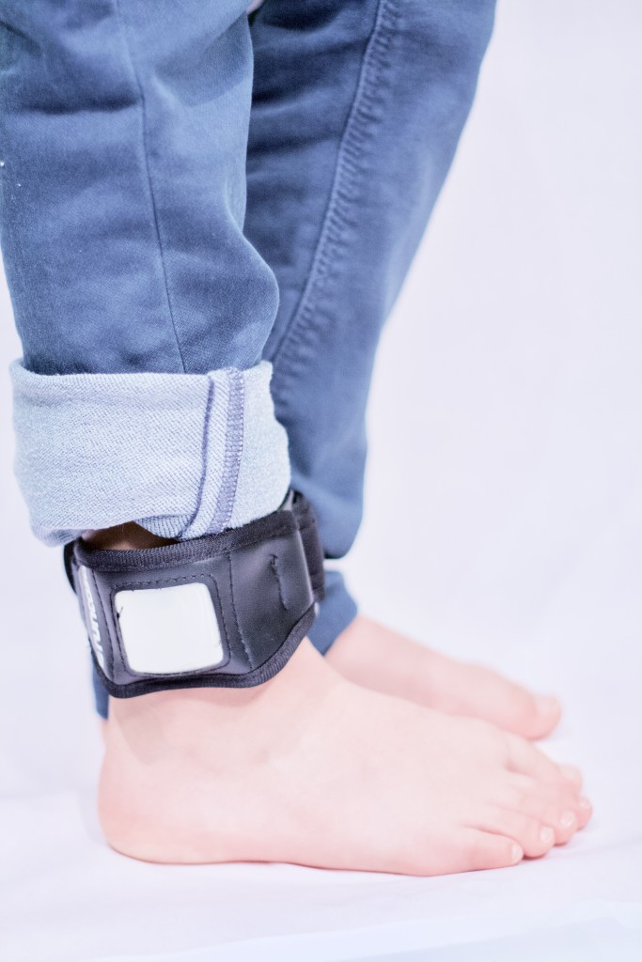
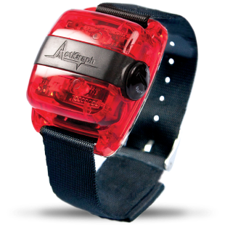
Digital Outcome Measures
Digitally measured outcomes allow:
Decentralisation of the trial;
More frequent and convenient measurements;
Potential for more sensitive measures.
Very early stages of development..
Case Study 1
Stride Velocity 95th Centile for Duchenne Muscular Dystrophy:
currently the only EMA-qualified digital outcome measure
Case Study 2 Time spent in MVPA for Pulmonary Hypertension with Interstitial Lung Disease: approved as a primary outcome by the FDA in a Phase III trial.

Slide 5
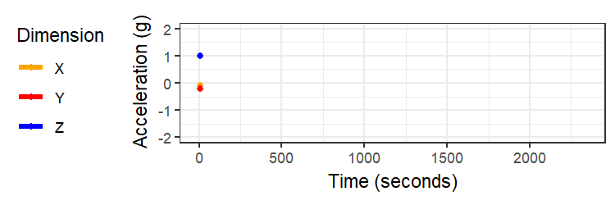
Digital Outcome Data
Raw data
Extremely high data volume
Acceleration in three dimensions at 100 Hz
Example: 30 min of data shown
Notes:
The data that you get is very different

Slide 6
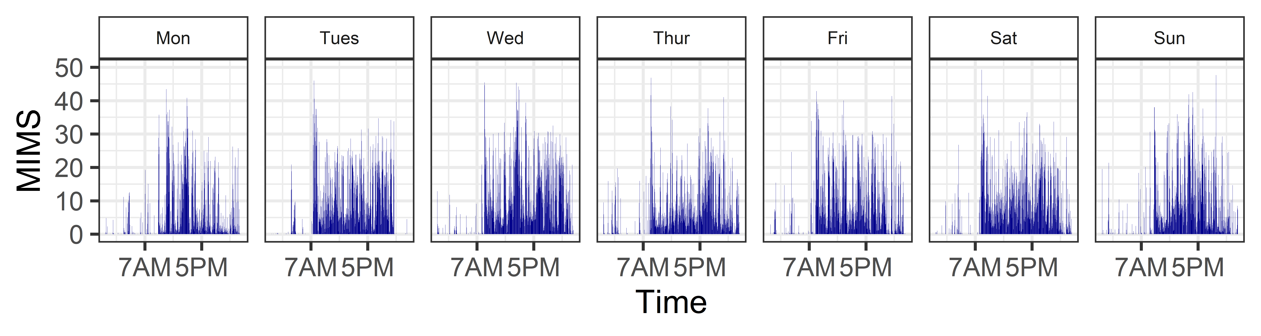
Digital Outcome Data
Epoch-level data
Monitor-Independent Movement Summary
Raw data processed by algorithm into physiological metrics at the epoch-level
Example: One week of minute-level data shown
Notes:
Physiological metric on a very small unit of time – minute Diurnal patterns

Slide 7
Digital Outcome Data
Summary-level Data
Average daily time spent in Moderate to Vigorous Physical Activity: 12.5min/day
Single numerical value representing physiological state

Slide 8
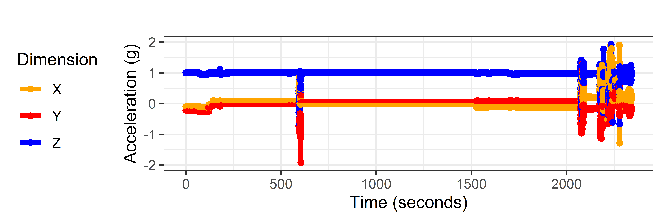
Digital Outcome Data
Raw data
Many decisions are being made as you aggregate the data, e.g.:
Summary metric
Choice of epoch
Handling of missing data, outliers…
Epoch-level data
Summary-level Data
12.5min/day of MVPA

Slide 9
Digital Outcome Data
Raw data
Question 1:
What is the appropriate granularity of the outcome?
Many decisions are being made as you aggregate the data, e.g.:
Summary metric;
Choice of epoch;
Handling of missing data.
Epoch-level data
Summary-level Data
12.5min/day of MVPA
Notes:
May depend on choice of analysis: Primary analysis, vs exploratory level. Question that comes with digital outcome measures

Slide 10
Outline
Potential of digital outcome measures (two iconic examples)
Key Methodological Questions:
In Validating Digital Outcome Measures
In using Digital Outcome Measures in Clinical Trials
Consequences on Primary Analysis via a Simulation Study
Notes:
How to validate digital outcome measures.

Slide 11
Case Study 1: Stride Velocity 95th Centile
For a primary outcome measure, a scalar summary of the data from the digital device may be desired.
Currently, there is only one digital outcome measure which has received regulatory qualification as a primary outcome: Stride Velocity 95th Centile (SV95C), measured over 180 hours, for Duchenne Muscular Dystrophy.
Qualification took over 10 years and used data from 9 studies (natural history studies and clinical trials). Beyond this case study, existing guidance includes:
V3+ framework by Digital Medicine Society (Bakker et al, 2024)
Regulatory guidance (FDA, 2023)
Statistical methods have received very limited attention.
Notes:
Assume that this is for primary outcome held as a prime example

Slide 12
Case Study 1: Stride Velocity 95th Centile
For a primary outcome measure, a scalar summary of the data from the digital device may be desired.
Currently, there is only one digital outcome measure which has received regulatory qualification as a primary outcome: Stride Velocity 95th Centile (SV95C), measured over 180 hours, for Duchenne Muscular Dystrophy. Qualification over 10 years and used data from 9 studies (natural history studies and clinical trials). Beyond this case study, existing guidance includes:
V3+ framework by Digital Medicine Society
Regulatory guidance
Statistical methods have received very limited attention.
Q2: What is the appropriate measurement period?
Q3: How is the ideal summary measure chosen?

Slide 13
V3+ Validation Framework
Usability Validation
Verification
Analytical Validation
Clinical Validation
Bakker et al., 2024. V3+ Framework
Goldsack et al,. 2020. V3 Framework Servais et al 2022. SV95C

Slide 14
V3+ Validation Framework
Usability Validation
Use specification: who, in what context, for what purpose? Identify risks and design to reduce them Inclusivity and acceptability
Verification
Analytical Validation
Clinical Validation
Bakker et al., 2024. V3+ Framework
Goldsack et al,. 2020. V3 Framework Servais et al 2022. SV95C

Slide 15
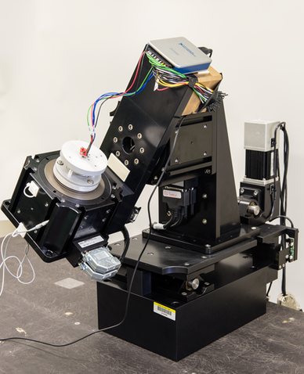
V3+ Validation Framework
Usability Validation
Verification
Testing accuracy/precision of raw data Evaluate consistency within and across devices
Analytical Validation
Clinical Validation
Bakker et al., 2024. V3+ Framework
Goldsack et al,. 2020. V3 Framework Servais et al 2022. SV95C

Slide 16
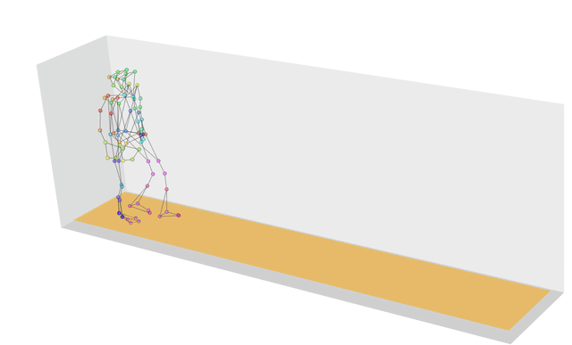
V3+ Validation Framework
Usability Validation
Verification
Accuracy: Compare of strides/stride speed captured by wearable device vs motion capture room.
Several scalar summaries (e.g. median stride velocity, 95th centile of stride velocity and mean distance walked) were evaluated in terms of:
Repeatability/Reliability¹: SV95C had high intra-cluster correlation based on two successive recordings 1 month apart (ICC 0.970, [0.947, 0.983]).
Robustness: Evaluate stability of measurements under varying conditions:
Weartime duration
Contextual factors (weekdays vs weekends)
Analytical Validation
Clinical Validation
Bakker et al., 2024. V3+ Framework
Goldsack et al,. 2020. V3 Framework Servais et al 2022. SV95C
Notes:
Accuracy – granular level (strides) for the next criteria – scalar summary.
When weartime is goes beyond 180hours – variability stabilisies – compliance is high
Includes both weekends and weekdays

Slide 17
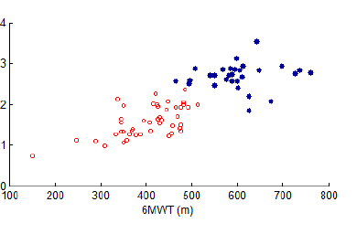
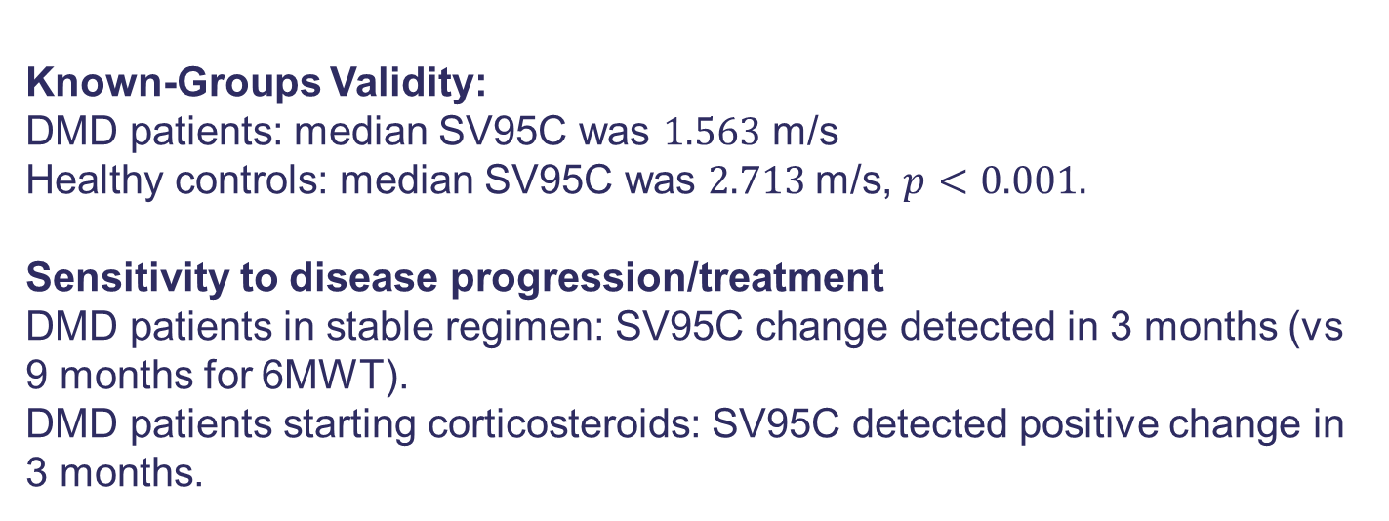
V3+ Validation Framework
Usability Validation
Healthy controls DMD
Convergent Validity: Correlation between SV95C and 6MWT was 0.657 at baseline.
Verification
SV95C m/s
Analytical Validation
Known-Groups Validity: DMD patients: median SV95C was $1.563$ m/s Healthy controls: median SV95C was $2.713$m/s, $p<0.001.$
Sensitivity to disease progression/treatment DMD patients in stable regimen: SV95C change detected in 3 months (vs 9 months for 6MWT).
DMD patients starting corticosteroids: SV95C detected positive change in 3 months.
6 Minute Walk Test (m)
Clinical Validation
Bakker et al., 2024. V3+ Framework
Goldsack et al,. 2020. V3 Framework Servais et al 2022. SV95C
Notes:
Clinical validation is about whether you can measure a clinical experience. How well it correlates well with the gold-standard 6MWT. Able to detect change quicker.

Slide 18
V3+ Validation Framework
As the only qualified primary digital outcome, the approach taken in SV95C may be incorrectly used a template in many contexts, in the absence of further guidance.
There is a need for:
a structured approach to the selection of summary metrics;
Standards for defining and reporting digital outcomes (Beauchamp et al 2020, Graña Possamai et al. 2020)
Embedding digital outcomes as exploratory/secondary endpoints in trials to assess sensitivity to change.
Notes:
Strides – functions

Slide 19
Outline
Potential of digital outcome measures (two iconic examples)
Key Methodological Questions:
In Validating Digital Outcome Measures
In using Digital Outcome Measures in Clinical Trials
Consequences on Primary Analysis via a Simulation Study

Slide 20
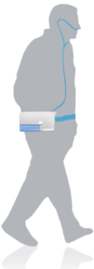


Case Study 2: Time spent in MVPA
Phase II Study Overview: Evaluated whether inhaled nitric oxide improves physical activity in patients with Pulmonary Hypertension associated with Interstitial Lung disease (King et al 2021). Treatment randomized on a 2:1 ratio to 44 patients.
Study Timeline:
Outcomes: 6 MWT, Oxygen Saturation, Time spent in MVPA, among others FDA approved time spent in MVPA in a Phase III trial as a primary outcome, with substantial reduction in sample size¹. The trial was stopped early for futility.
Baseline
Follow-up
Month 1
Month 2
Month 3
Month 4
Month 5
Notes:
Only 2 weeks – found this was insufficient, and re-do the run-in period

Slide 21
Question 4: What are appropriate estimands for digital outcome measures?
Population 6MWT may exclude people in remote locations; MVPA may exclude those unwilling/unable to use digital devices
Variable 6MWT I saffected by fatigue/motivation. MVPA may better reflect patients’ experiences, but is affected by seasonal/behavioral factors.
Intercurrent Events
Treatment
Population level summary
Izem et. al (2024)

Slide 22
Question 4: What are appropriate estimands for digital outcome measures?
Alignment with target Population 6MWT may exclude people in remote locations; MVPA may exclude those unwilling/unable to use digital devices
Variable 6MWT I saffected by fatigue/motivation. MVPA may better reflect patients’ experiences, but is affected by seasonal/behavioral factors.
Intercurrent Events
Treatment
Population level summary
Izem et. al (2024)

Slide 23
Question 4: What are appropriate estimands for digital outcome measures?
Alignment with target Population 6MWT may exclude people in remote locations; MVPA may exclude those unwilling/unable to use digital devices
How much the Variable captures the scientific question 6MWT is affected by fatigue/motivation; MVPA may better reflect patients’ experiences but is affected by seasonal/behavioral factors.
Intercurrent Events New intercurrent events due to technical issues, e.g. software updates
Treatment
Population level summary
Izem et. al (2024)

Slide 24
Question 4: What are appropriate estimands for digital outcome measures?
Alignment with target Population 6MWT may exclude people in remote locations; MVPA may exclude those unwilling/unable to use digital devices
How much the Variable captures the scientific question 6MWT is affected by fatigue/motivation. MVPA may better reflect patients’ experiences,but is affected by seasonal/behavioral factors.
Type/Frequency of Intercurrent Events New intercurrent events due to technical issues, e.g. software updates
Treatment
Population level summary
Izem et. al (2024)

Slide 25
Question 4: What are appropriate estimands for digital outcome measures?
Alignment with target Population 6MWT may exclude people in remote locations; MVPA may exclude those unwilling/unable to use digital devices
How much the Variable captures the scientific question 6MWT is affected by fatigue/motivation. MVPA may better reflect patients’ experiences but is affected by seasonal/behavioral factors.
Type/Frequency of Intercurrent Events New intercurrent events due to technical issues, e.g. software updates
Treatment No Impact
Population level summary
Izem et. al (2024)

Slide 26
Question 4: What are appropriate estimands for digital outcome measures?
Alignment with target Population 6MWT may exclude people in remote locations; MVPA may exclude those unwilling/unable to use digital devices
How much the Variable captures the scientific question 6MWT is affected by fatigue/motivation. MVPA may better reflect patients’ experiences but is affected by seasonal/behavioral factors.
Type/Frequency of Intercurrent Events New intercurrent events due to technical issues, e.g. software updates
Treatment No Impact
How the Population level summary is derived Choice of summary may be more complex for time spent in MVPA, e.g. defining missing data.
Izem et. al (2024)

Slide 27
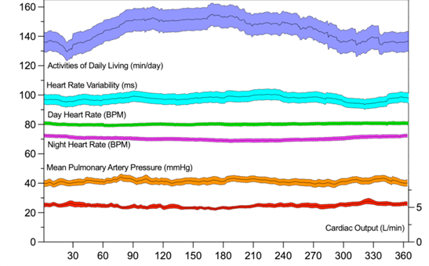
Question 5: How do seasonal/behavioural variations affect design/analysis?
Physical activity measured in free-living conditions alters significantly by season.
Behavioral variations include observer effects and learning/practice effects (Woelfle et al 2021).
Important implications for design/analysis of studies:
Timing of recruitment;
Adjusting for season in the analysis;
Discarding initial ‘learning’ period.
Cardiac Monitor Data
Day of Year
Insertable cardiac monitor data in patients with Pulmonary Hypertension by day of the year (mean +/- SEM) [Rothman et al (2025)]

Slide 28
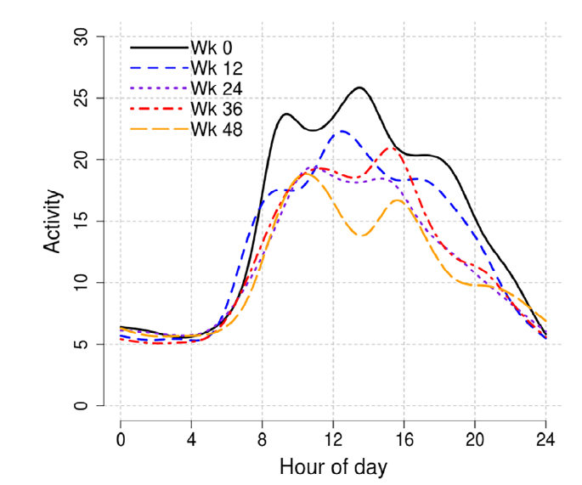
Question 6: How do we exploit the granularity of digital outcome measures to learn more about the treatment?
Flexible modelling approaches on epoch-level data e.g. Generalised Additive Models or Functional Data Analysis, can provide insight into disease progression/treatment.
These methods may help identify more sensitive endpoints based on time of day.
Estimated smooth curves of physical activity for 5 selected week-long periods in an observational study on ALS [Lisi and Abellan (2023)]

Slide 29
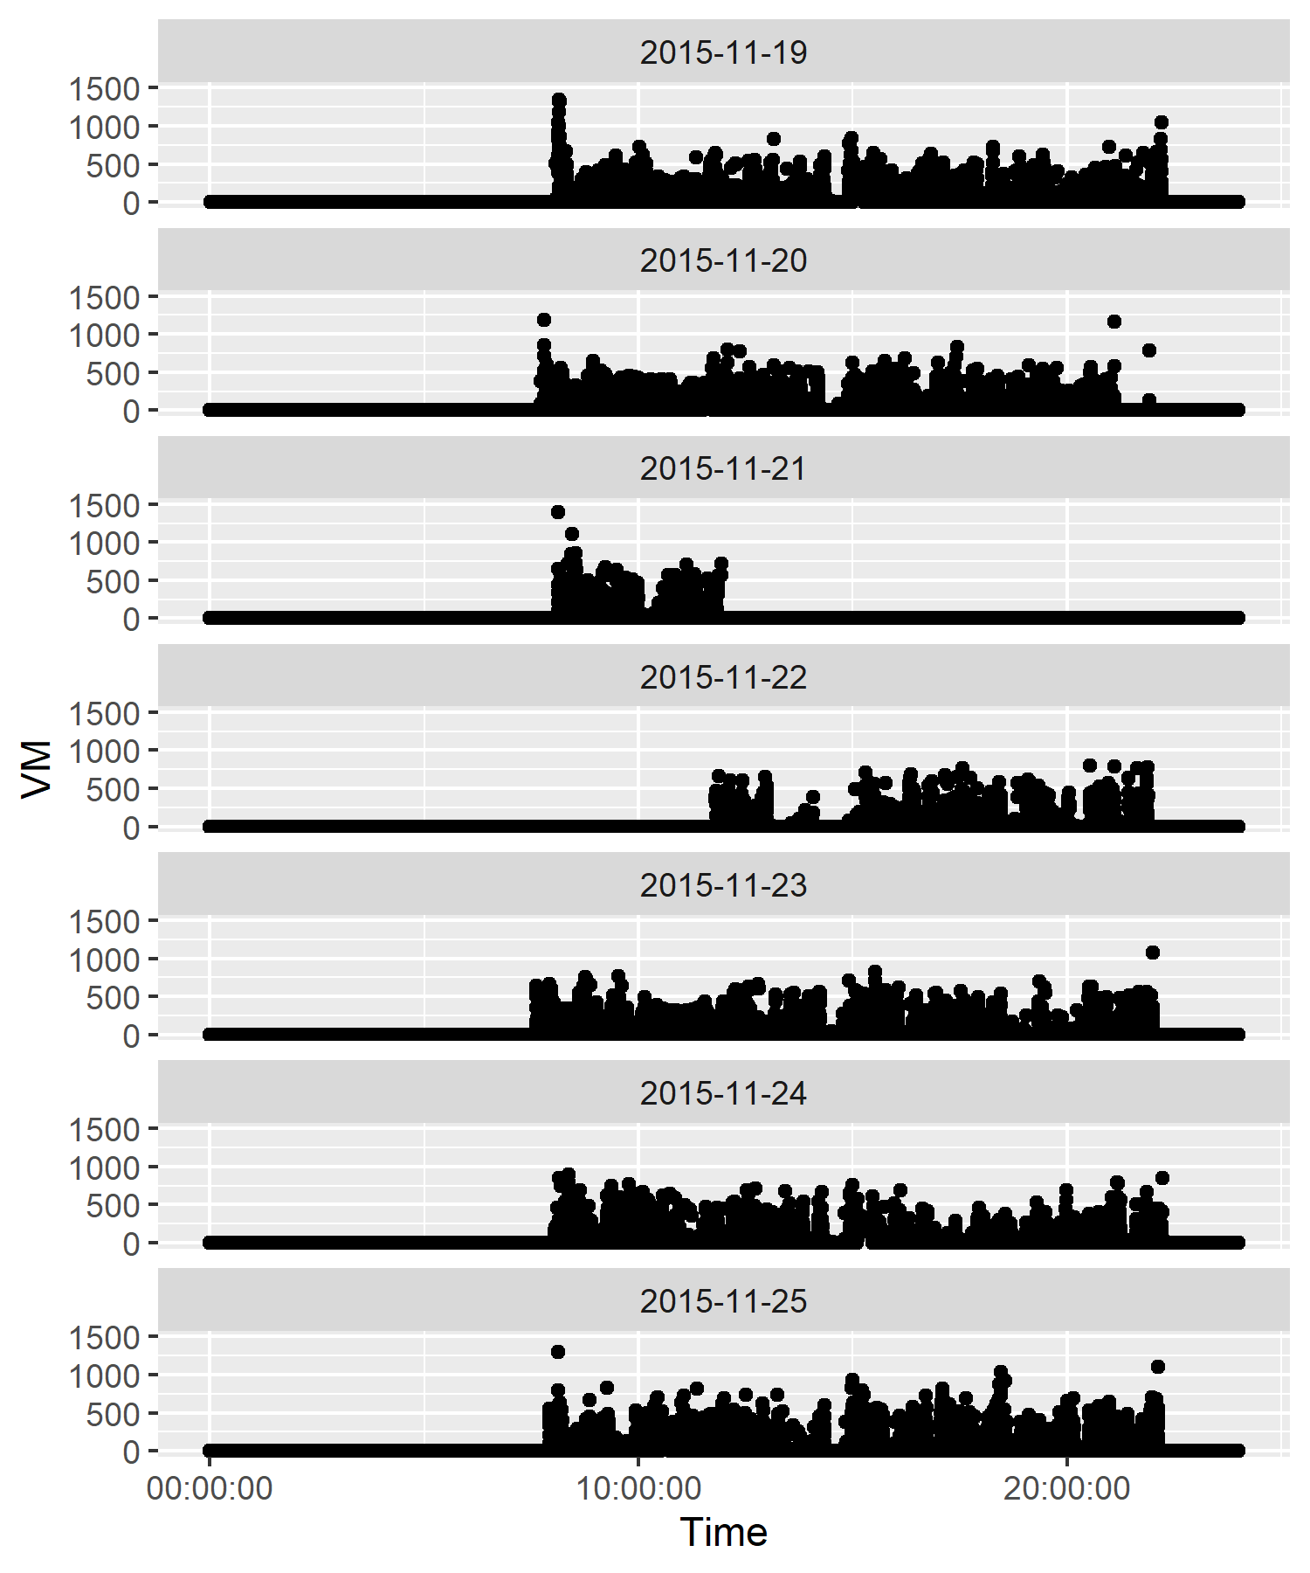
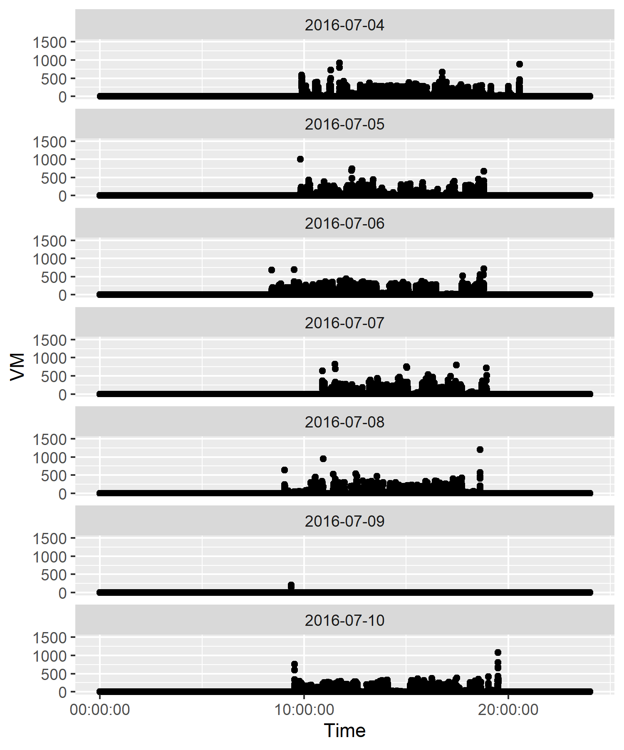
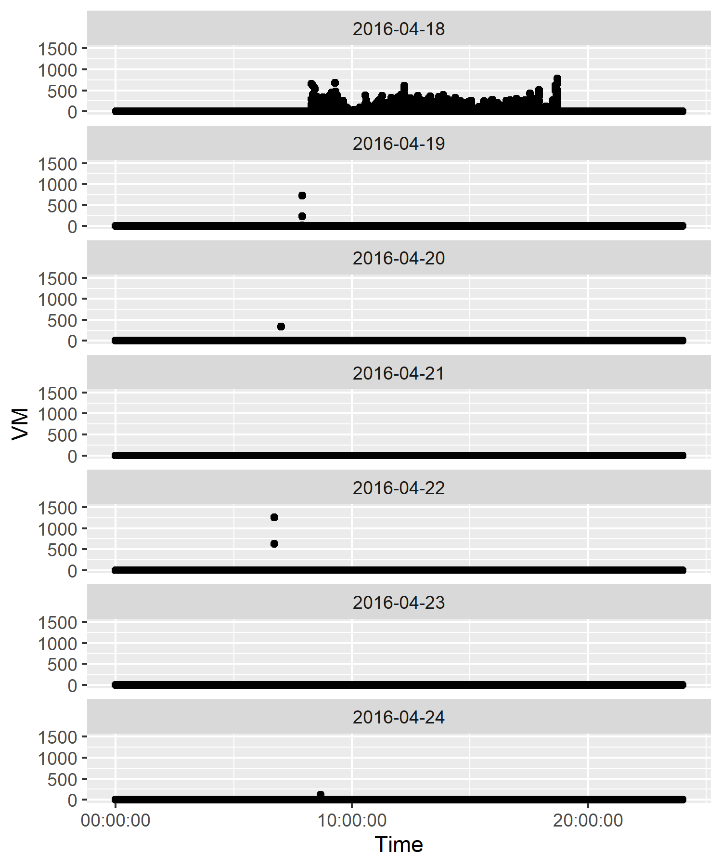
Question 7: How is missing data defined and handled?
No consensus on defining missing data: typically defined by weartime thresholds.

Slide 30
Question 7: How is missing data defined and handled?
No consensus on defining missing data: typically defined by weartime thresholds.
Threshold usually chosen ad-hoc and may not be suitable for the chosen population¹.
Analyses often assume that data are Missing Completely at Random (often unrealistic for this setting).
642 Minutes
539 Minutes
623 Minutes
483 Minutes
612 Minutes
0 Minutes
605 Minutes

Slide 31
Question 7: How is missing data defined and handled?
No consensus on defining missing data: typically defined by weartime thresholds.
Threshold usually chosen ad-hoc and may not be suitable for the chosen population¹.
Analyses often assume that data are Missing Completely at Random (often unrealistic for this setting).
Our recent Multiple Imputation framework for accelerometer data (Tackney et al 2021, 2023):
-defines missing intervals of days; -uses non-parametric imputations; -provides examples of sensitivity analyses.
…more work needed!

Slide 32
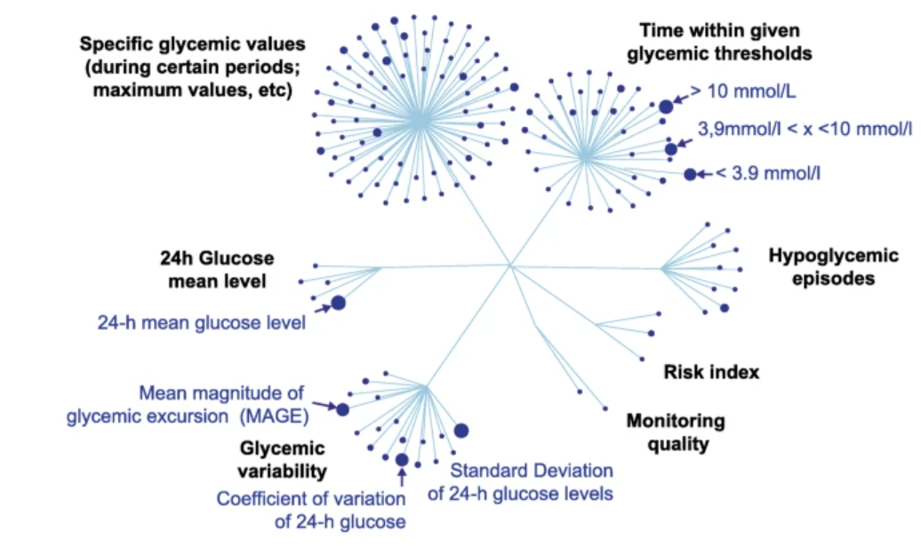
Question 8: Is evidence synthesis possible?
A review identified 266 digital outcomes from 21 diabetes trials, mostly as exploratory outcomes (Graña Possamai et. al, 2020).
Even within a specific digital outcome, there many points of discretion which pose challenges for evidence synthesis going forward.

Slide 33
Outline
Potential of digital outcome measures (two iconic examples)
Key Methodological Questions:
In Validating Digital Outcome Measures
In using Digital Outcome Measures in Clinical Trials
Consequences on Primary Analysis via a Simulation Study

Slide 34
Eight methodological questions
Q1: What is the appropriate outcome granularity?
Q2: What is the appropriate measurement period?
Q3: How is the summary measure chosen?
Q4: What are appropriate estimands for digital outcome
measures?
Q5: How do seasonal/behavioral variations affect
design/analysis?
Q6: How do we exploit the granularity of digital outcome measures to learn more about the treatment?
Q7: How are missing data defined and handled?
Q8: Is evidence synthesis possible?

Slide 35
Eight methodological questions
Q1: What is the appropriate outcome granularity?
Q2: What is the appropriate measurement period?
Q3: How is the summary measure chosen?
Q4: What are appropriate estimands for digital outcome
measures?
Q5: How do seasonal/behavioral variations affect
design/analysis?
Q6: How do we exploit the granularity of digital outcome measures to learn more about the treatment?
Q7: How are missing data defined and handled?
Q8: Is evidence synthesis possible?

Slide 36
Simulation Study
44 participants were randomized on a 2:1 ratio to the new treatment. They wore the accelerometer for four weeks at baseline and four weeks at follow-up.
What is the impact on the primary analysis of the digital outcome measure if:
Due to seasonality, some patients have higher MVPA at follow-up?
Due to an observer effect, week 1 has higher MVPA than other weeks?
The measurement period is two weeks instead of four weeks?
Outcomes are Missing Completely at Random or Missing Not at Random?
Baseline
Follow-up
Month 1
Month 2
Month 3
Month 4
Month 5
Notes:
What if some participants are recruited in the winter, and have their followup in the summer, and therefore have a higher MVPA at follow-up simply due to the seasonality?

Slide 37


Simulation Study: Primary Analysis
Suppose we have a simplified analysis of the digital outcome measure:
$y_{i,j}:$daily time spent in MVPA for individual i on day j at follow-up;
$\overline{y_{i,.}}:$average time spent in MVPA for individual i from compliant days (at least 600 minutes of weartime)
$$\overline{y_{i,.}}=β_{0}+β_{1}baseline_{i}+β_{2}treat_{i}+ε_{i}$$
where $ε_{i}∼N(0, σ^{2})$
Notes:
We assume a very simplified analysis regress the average time spent at follow-up to average time spent at baseline and treatment

Slide 38

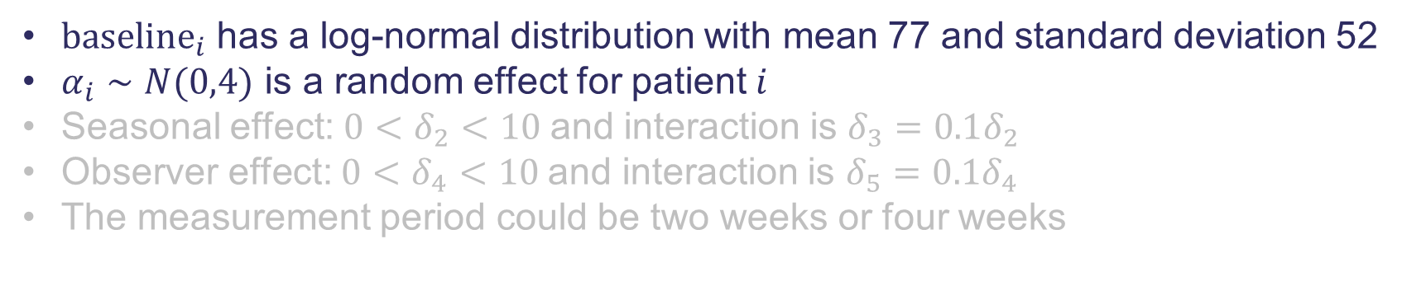
Data Generating Mechanism
We assume a log-normal distribution for $y_{ij}$ with mean $μ_{ij}$ and standard deviation 46:
$$μ_{ij}={baseline}_{i}+12.5 I\left({treat}_{i}=1\right)$$
$$+ δ_{2}I\left(patient i recruited in winter\right)$$
$+ δ_{3}I\left(patient i recruited in winter\right)$ $I\left({treat}_{i}=1\right)$
$$+ δ_{4}I\left(day j in week 1\right)$$
$+ δ_{5}I\left(day j in week 1\right)$ $I\left({treat}_{i}=1\right)$
$$+ α_{i}$$
$baseline_{i}$has a log-normal distribution with mean 77 and standard deviation 52
$α_{i}∼N(0,4)$ is a random effect for patient $i$
Seasonal effect: $0<δ_{2}<10$and interaction is $δ_{3}=0.1δ_{2}$
Observer effect: $0<δ_{4}<10$and interaction is $δ_{5}=0.1δ_{4}$
The measurement period could be two weeks or four weeks
Notes:
We simulate daily time spent in MVPA. This is a skewed outcome, so we model this as a log-normal distribution with mean Muij and standard deviation 46. mu has a component for baseline time spent in MVPA – treatment effect is 12.5 – values taken to be similar to that of the trial.

Slide 39

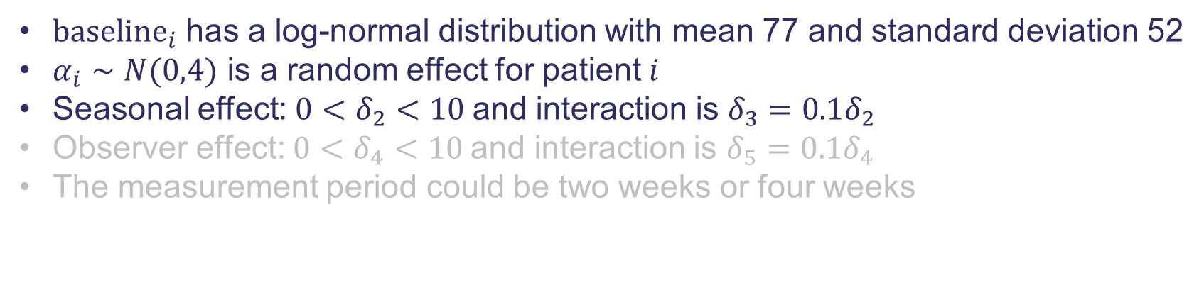
Data Generating Mechanism
We assume a log-normal distribution for $y_{ij}$ with mean $μ_{ij}$ and standard deviation 46:
$$μ_{ij}={baseline}_{i}+12.5 I\left({treat}_{i}=1\right)$$
$$+ δ_{2}I\left(patient i recruited in winter\right)$$
Seasonal effect
$+ δ_{3}I\left(patient i recruited in winter\right)$ $I\left({treat}_{i}=1\right)$
$$+ δ_{4}I\left(day j in week 1\right)$$
$+ δ_{5}I\left(day j in week 1\right)$ $I\left({treat}_{i}=1\right)$
$$+ α_{i}$$
$baseline_{i}$has a log-normal distribution with mean 77 and standard deviation 52
$α_{i}∼N(0,4)$ is a random effect for patient $i$
Seasonal effect: $0<δ_{2}<10$and interaction is $δ_{3}=0.1δ_{2}$
Observer effect: $0<δ_{4}<10$and interaction is $δ_{5}=0.1δ_{4}$
The measurement period could be two weeks or four weeks
Notes:
We now introduce some additional effects. If some participants, if they are recruited in the winter and followed up in the summer, there is an additive effect and potentially and interaction with treatment
Analogously, we have an additive effect for the observer effect for days in week 1 and potentially also an interaction with treatment

Slide 40
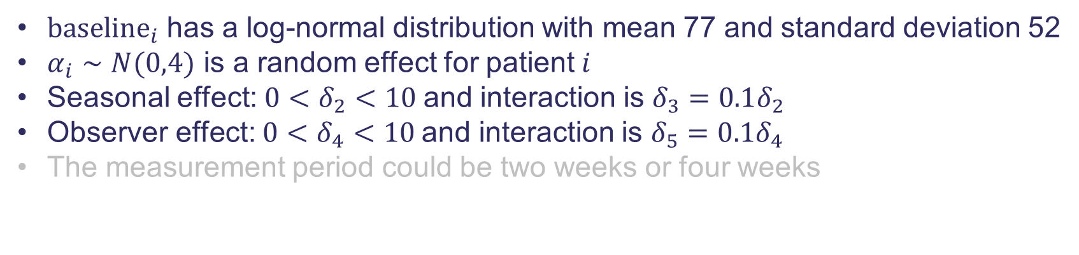
Data Generating Mechanism
We assume a log-normal distribution for $y_{ij}$ with mean $μ_{ij}$ and standard deviation 46:
$$μ_{ij}={baseline}_{i}+12.5 I\left({treat}_{i}=1\right)$$
$$+ δ_{2}I\left(patient i recruited in winter\right)$$
$+ δ_{3}I\left(patient i recruited in winter\right)$ $I\left({treat}_{i}=1\right)$
$$+ δ_{4}I\left(day j in week 1\right)$$
Observer effect
$+ δ_{5}I\left(day j in week 1\right)$ $I\left({treat}_{i}=1\right)$
$$+ α_{i}$$
$baseline_{i}$has a log-normal distribution with mean 77 and standard deviation 52
$α_{i}∼N(0,4)$ is a random effect for patient $i$
Seasonal effect: $0<δ_{2}<10$and interaction is $δ_{3}=0.1δ_{2}$
Observer effect: $0<δ_{4}<10$and interaction is $δ_{5}=0.1δ_{4}$
The measurement period could be two weeks or four weeks

Slide 41
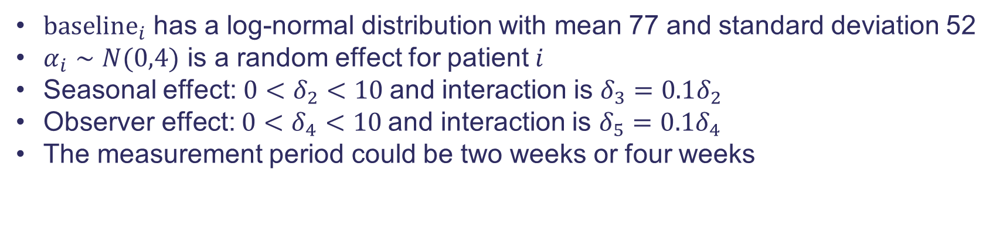
Data Generating Mechanism
We assume a log-normal distribution for $y_{ij}$ with mean $μ_{ij}$ and standard deviation 46:
$$μ_{ij}={baseline}_{i}+12.5 I\left({treat}_{i}=1\right)$$
$$+ δ_{2}I\left(patient i recruited in winter\right)$$
$+ δ_{3}I\left(patient i recruited in winter\right)$ $I\left({treat}_{i}=1\right)$
$$+ δ_{4}I\left(day j in week 1\right)$$
Observer effect
$+ δ_{5}I\left(day j in week 1\right)$ $I\left({treat}_{i}=1\right)$
$$+ α_{i}$$
$baseline_{i}$has a log-normal distribution with mean 77 and standard deviation 52
$α_{i}∼N(0,4)$ is a random effect for patient $i$
Seasonal effect: $0<δ_{2}<10$and interaction is $δ_{3}=0.1δ_{2}$
Observer effect: $0<δ_{4}<10$and interaction is $δ_{5}=0.1δ_{4}$
The measurement period could be two weeks or four weeks

Slide 42
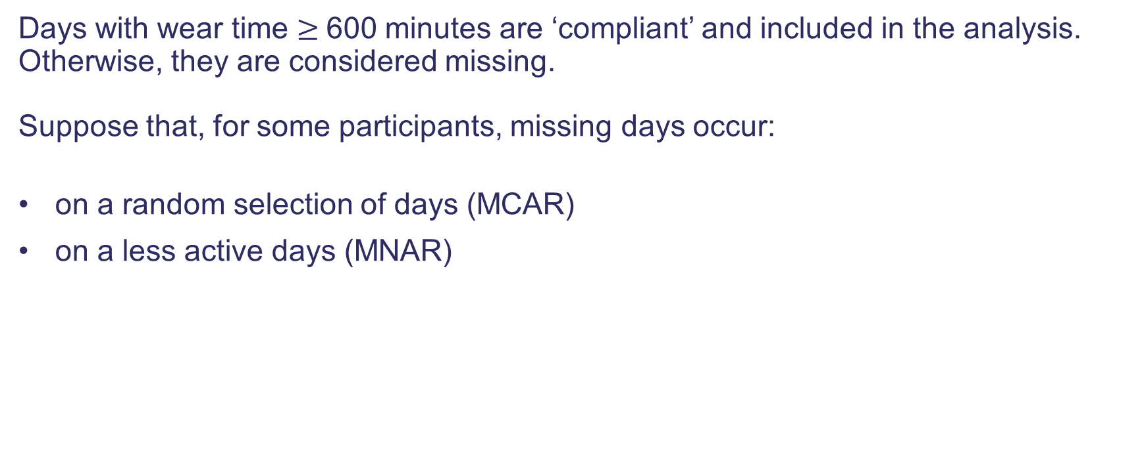
Missing Data Mechanism
Days with wear time $≥$600 minutes are ‘compliant’ and included in the analysis. Otherwise, they are considered missing. Suppose that, for some participants, missing days occur:
on a random selection of days (MCAR)
on a less active days (MNAR)

Slide 43
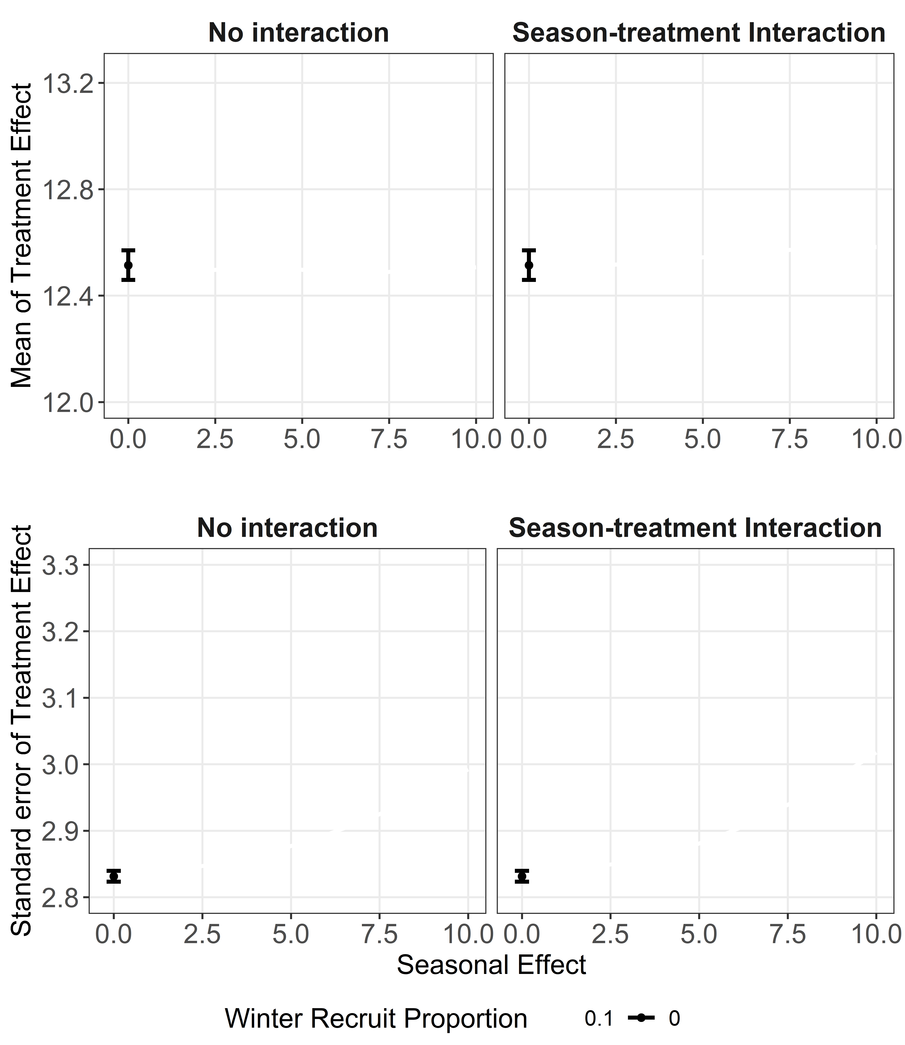
Seasonality
True effect of treatment: 12.5 min/day.
Notes:
At the top: mean of treatment effect, bottom: standard error of treatment effect. In the absence of any seasonality, the treatment effect is 12.5.

Slide 44
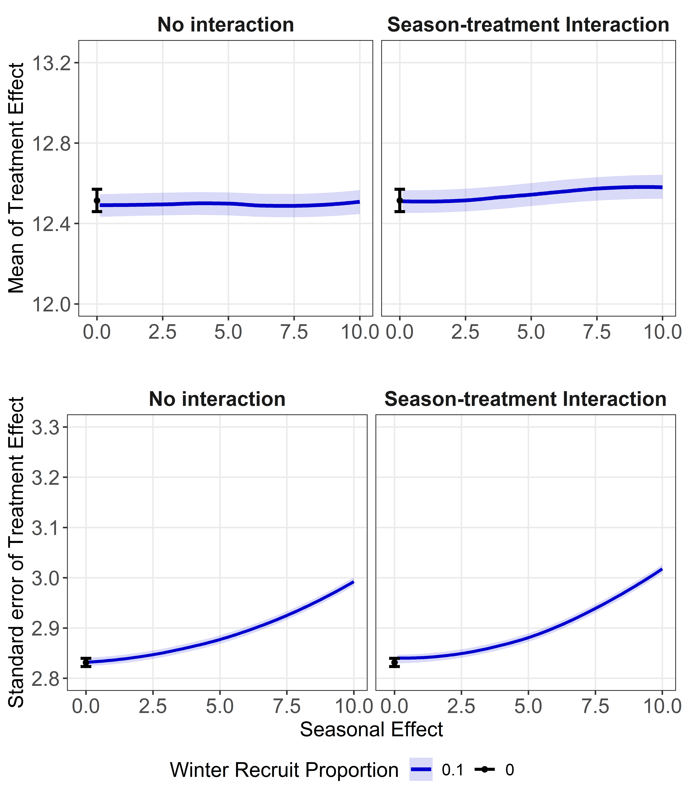
Seasonality
True effect of treatment: 12.5 min/day.
If patients experience a seasonal effect, but there is no interaction with treatment: → no bias, increased standard error
Notes:
As the seasonal effect increases from 0 to 10, if 10% of participants experience seasonal effect..

Slide 45
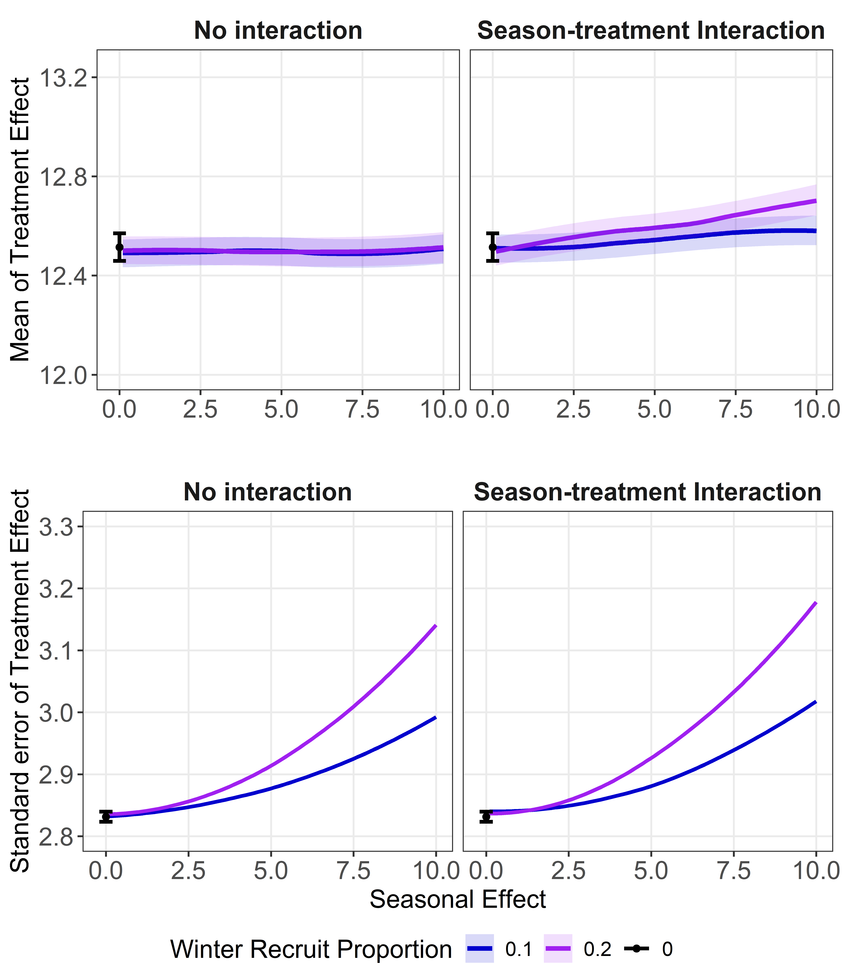
Seasonality
True effect of treatment: 12.5 min/day.
If patients experience a seasonal effect, but there is no interaction with treatment: → no bias, increased standard error

Slide 46
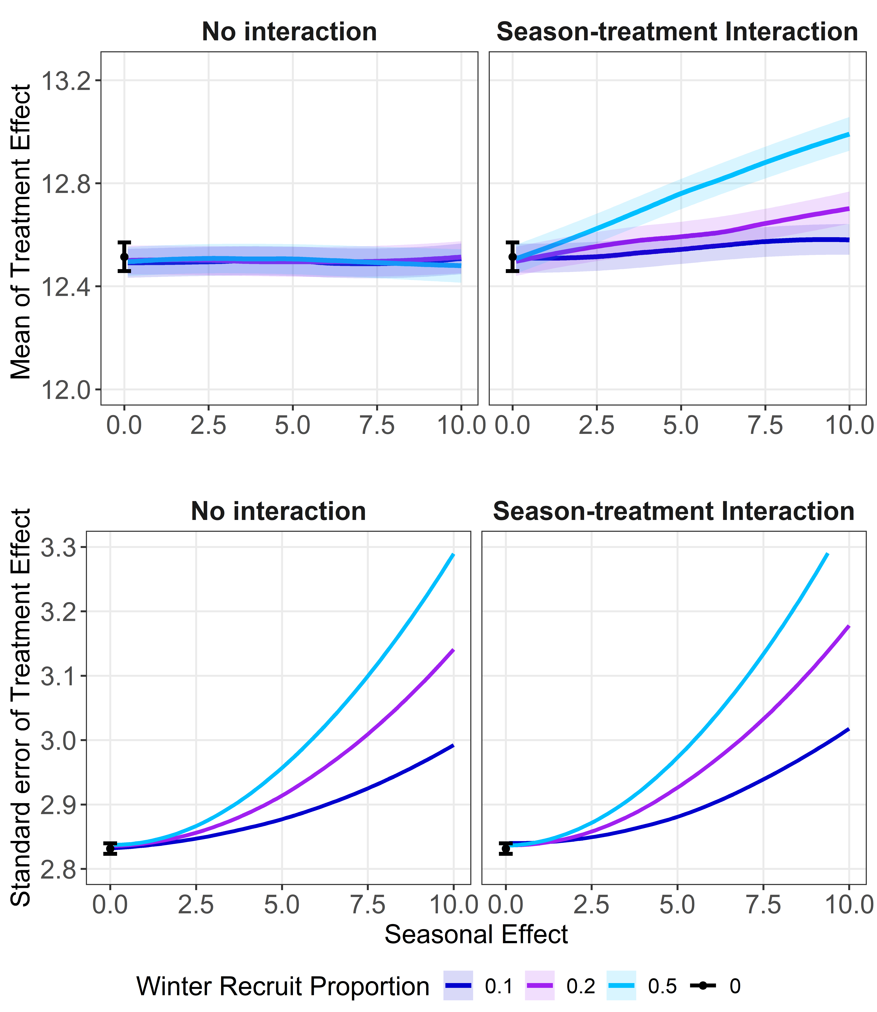
Seasonality
True effect of treatment: 12.5 min/day.
If patients experience a seasonal effect, but there is no interaction with treatment: → no bias, increased standard error
If there is a season-treatment interaction: → bias and increased standard error

Slide 47
Seasonality
True effect of treatment: 12.5 min/day.
If patients experience a seasonal effect, but there is no interaction with treatment: → no bias, increased standard error
If there is a season-treatment interaction: → bias and increased standard error

Slide 48
Seasonality
True effect of treatment: 12.5 min/day.
If patients experience a seasonal effect, but there is no interaction with treatment: → no bias, increased standard error
If there is a season-treatment interaction: → bias and increased standard error
Implications:
Consider recruiting at appropriate times of year;
Consider adjusting for season in the analysis

Slide 49
Missing Data
True effect of treatment: 12.5 min/day. Suppose that 10%, 20% and 50% of patients have missing outcomes.

Slide 50
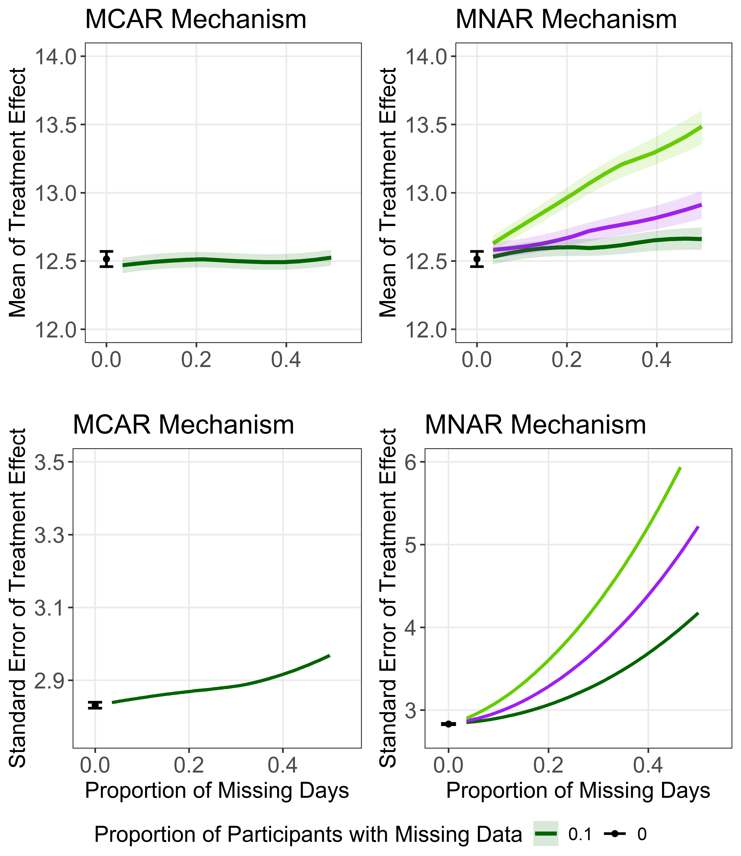
Missing Data
True effect of treatment: 12.5 min/day. Suppose that 10%, 20% and 50% of patients have missing outcomes.
Under MCAR: → no bias, increased SE.

Slide 51
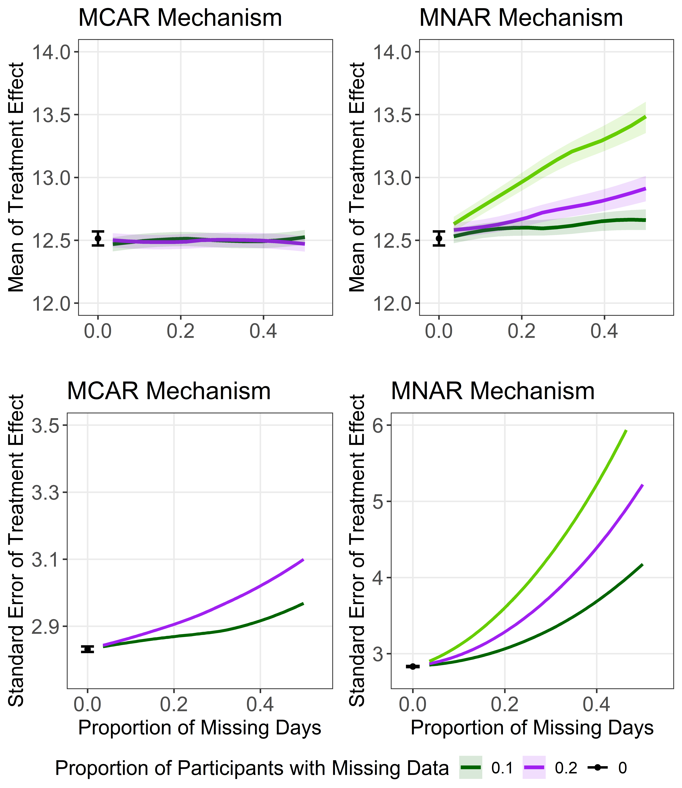
Missing Data
True effect of treatment: 12.5 min/day. Suppose that 10%, 20% and 50% of patients have missing outcomes.
Under MCAR: → no bias, increased SE.

Slide 52
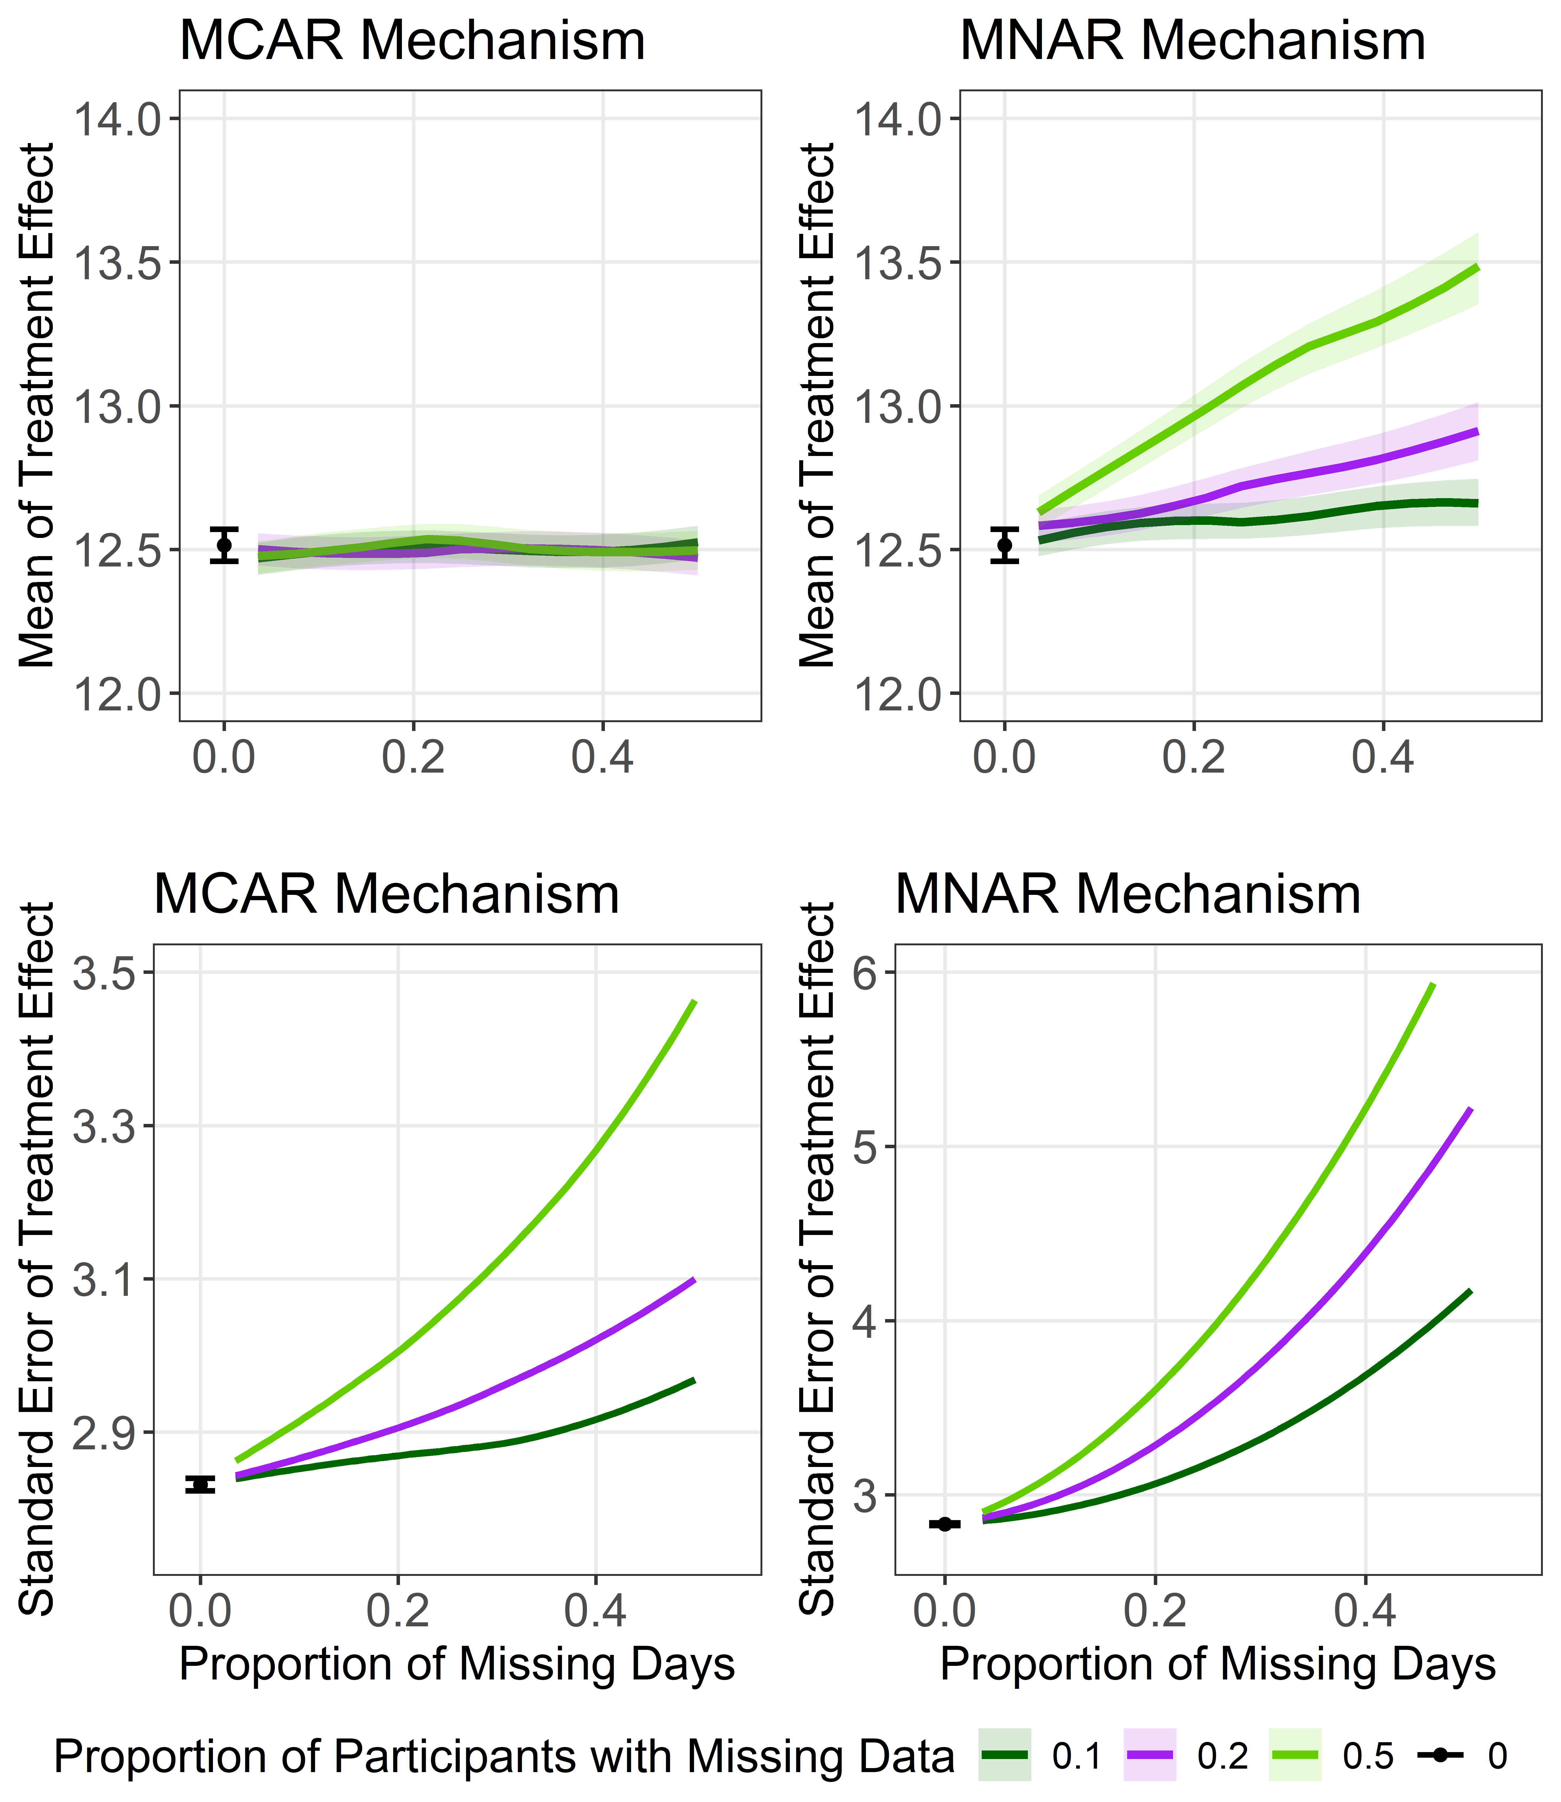
Missing Data
True effect of treatment: 12.5 min/day. Suppose that 10%, 20% and 50% of patients have missing outcomes.
Under MCAR: → no bias, increased SE.

Slide 53
Missing Data
True effect of treatment: 12.5 min/day. Suppose that 10%, 20% and 50% of patients have missing outcomes.
Under MCAR: → no bias, increased SE. Under MNAR: → bias and increased SE.

Slide 54
Missing Data
True effect of treatment: 12.5 min/day. Suppose that 10%, 20% and 50% of patients have missing outcomes.
Under MCAR: → no bias, increased SE. Under MNAR: → bias and increased SE. Implications:
Need for sensitivity analyses to missing data assumptions;
Imputing at lower level of granularity may be useful.

Slide 55
Digital Outcome Measures
Key benefits of digital outcome measures:
More meaningful to patients;
Lower burden (enable decentralization);
More sensitive – can lead to lower sample sizes;
New insights via high-frequency data.
Stride Velocity 95th Centile
Time spent in MVPA

Slide 56
A Call to Attention: Eight methodological questions
Q1: What is the appropriate outcome granularity?
Q2: What is the appropriate measurement period?
Q3: How is the summary measure chosen?
Q4: What are appropriate estimands for digital outcome
measures?
Q5: How do seasonal/behavioral variations affect
design/analysis?
Q6: How do we exploit the granularity of digital outcome measures to learn more about the treatment?
Q7: How are missing data defined and handled?
Q8: Is evidence synthesis possible?

Slide 57
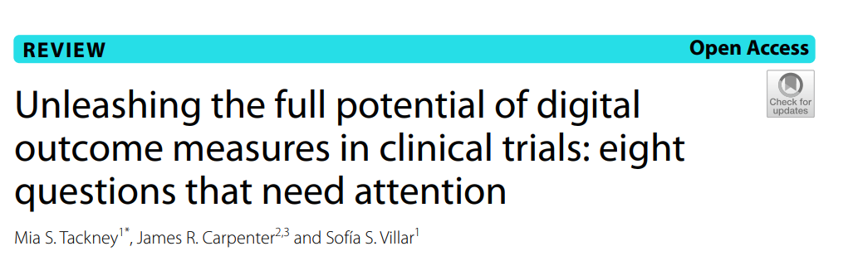
Thank you

Slide 58
References
Bakker et al, 2024. V3+: An extension to the v3 framework to ensure user-centricity and scalability of sensor-based digital health technologies.
European Medicines Agency. Draft Qualification Opinion for Stride velocity 95th centile as primary endpoint in studies in ambulatory Duchenne Muscular Dystrophy studies. 2023. Graña Possamai C, Ravaud P, Ghosn L, Tran VT. Use of wearable biometric monitoring devices to measure outcomes in randomized clinical trials: a methodological systematic review. BMC Med. 2020;18(1):1–11. doi: 10.1186/s12916-020-01773-w
Izem, R., Zuber, E., Daizadeh, N. et al. Decentralized Clinical Trials: Scientific Considerations Through the Lens of the Estimand Framework. Ther Innov Regul Sci 58, 495–504 (2024). doi: 10.1007/s43441-024-00615-8
King, et al, 2022. A Phase-2 Exploratory Randomized Controlled Trial of INOpulse in Patients with Fibrotic Interstitial Lung Disease Requiring Oxygen. doi: 10.1513/AnnalsATS.202107-864OC [Phase II study: NCT01457781, Phase III study: NCT03267108] Lisi E, Abellan JJ. Statistical analysis of actigraphy data with generalised additive models. Pharm Stat. 2023. doi: 10.1002/pst.2350
Servais L, Yen K, Guridi M, Lukawy J, Vissière D, Strijbos P. Stride Velocity 95th Centile: insights into gaining regulatory qualification of the first wearable-derived digital endpoint for use in Duchenne muscular dystrophy trials. J Neuromuscul Dis. 2022;9(2):335–46. doi: 10.3233/JND-210743 U.S. Food and Drug Administration. Digital Health Technologies for Remote Data Acquisition in Clinical Investigations. December 2023. Guidance Document, Docket No. FDA-2021-D-1128. Available at: https://www.fda.gov/regulatory-information/search-fda-guidance-documents/digital-health-technologies-remote-data-acquisition-clinical-investigations

